Slide 1
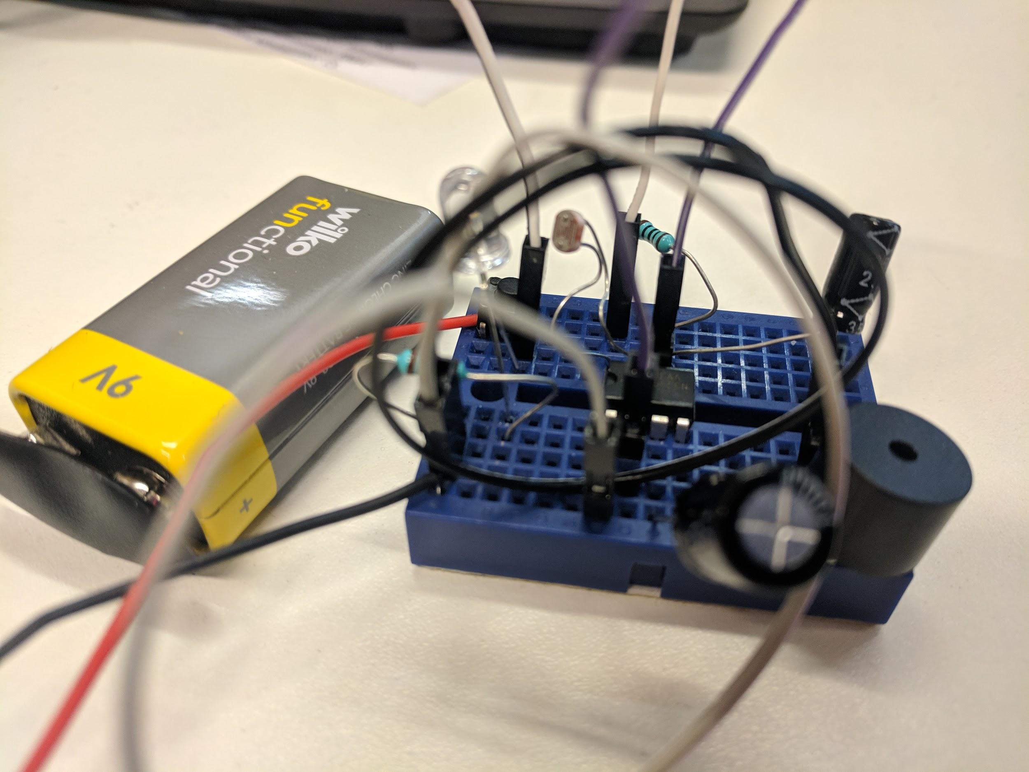


Breadboard Musical Instrument
A workshop for
By Joe Brown
13th Feb 2019

Slide 2
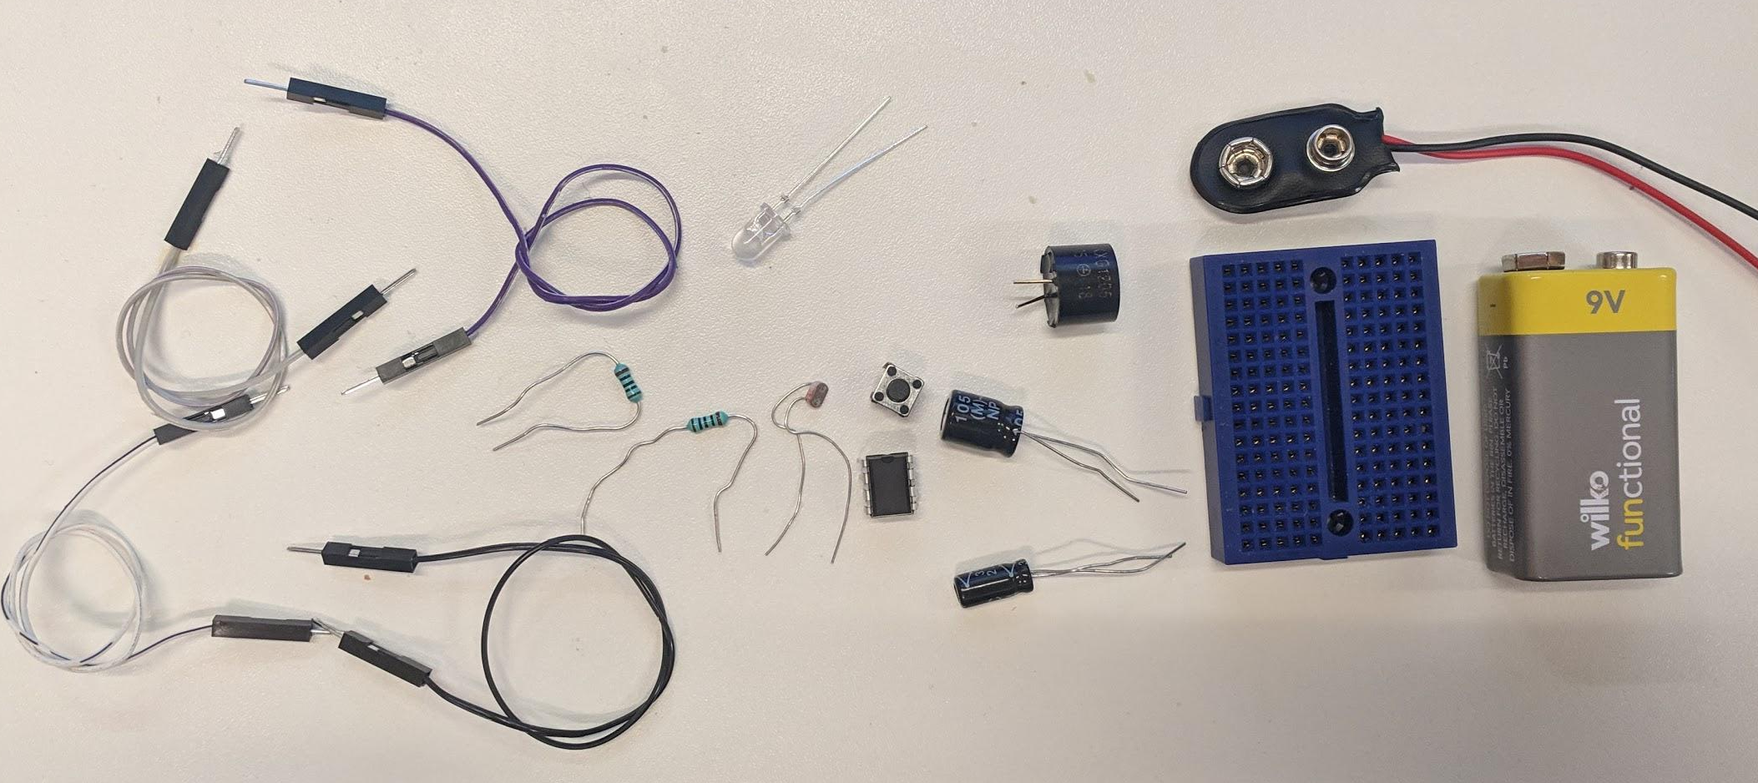
Parts needed:
Battery Clip
White LED
Buzzer
LDR
button
2x 100Ω
resistors
100uF Capacitor
4x jumper cables
555
2.2uF Capacitor
Breadboard
9V Battery

Slide 3
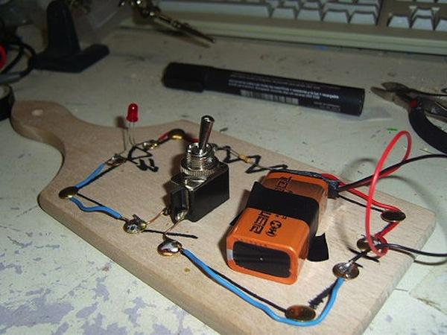
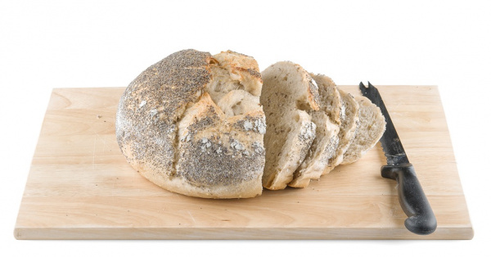
Why BreadBoard?
Early electronic circuits were made using nails and wires connected to spare breadboards normally used for slicing bread!
The nickname stuck as new more suitable boards for electronics were made.

Slide 4
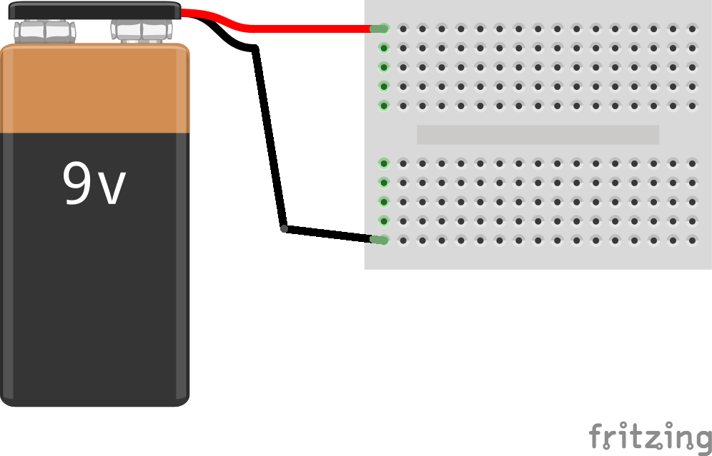
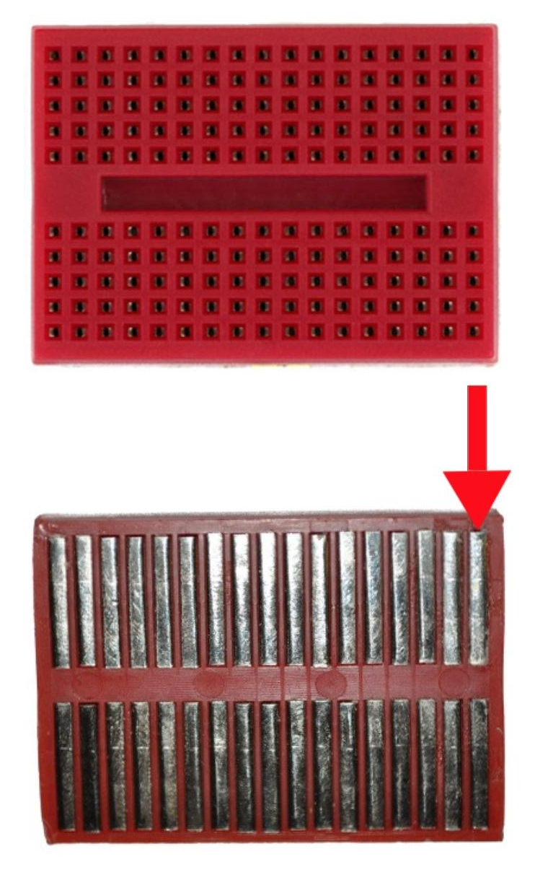
1: Connect your battery connector to your breadboard.
Holes down the lines of the breadboard are connected up like the ones marked in green. This is a terminal strip.
Red wire on the top left
Electronics plugged into these holes are connected together by metal strips inside the breadboard - the terminal strip.
Black wire on the bottom left

Slide 5

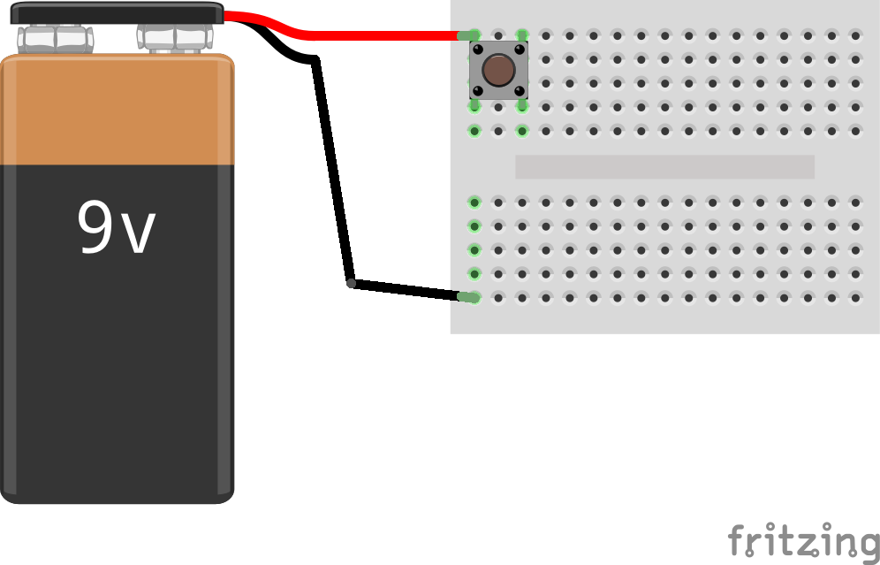
2: Add the button.
Position your button
this way round
Line it up vertically
With the red battery wire
The button on the switch will be used to ‘play’ or ‘strum’ your instrument!

Slide 6
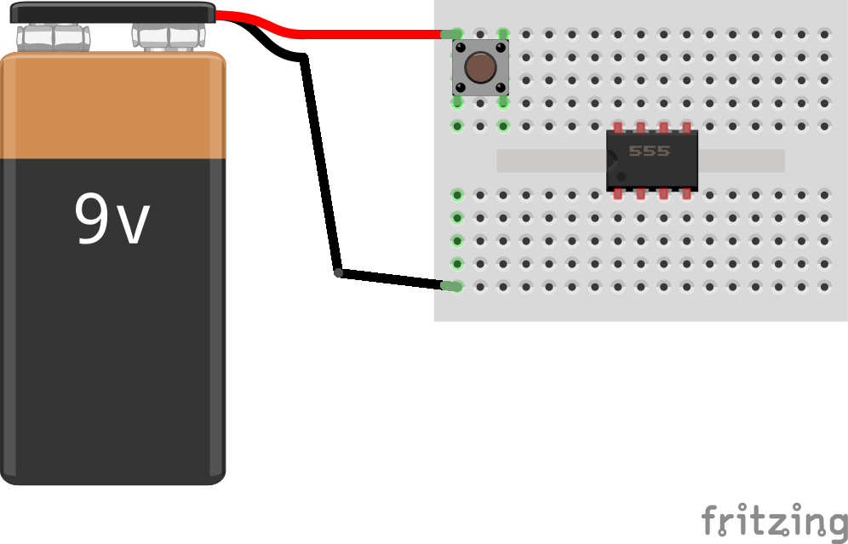
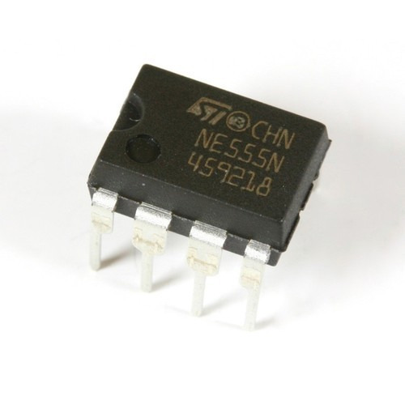
3: Add 555 in middle of the breadboard, with the notch on the left
Notch on
One side
A 555 is a chip that produces pulses and in the case of our musical instrument it will be generating the sounds!

Slide 7
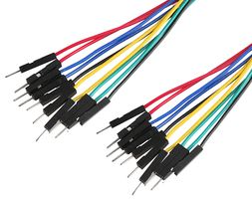
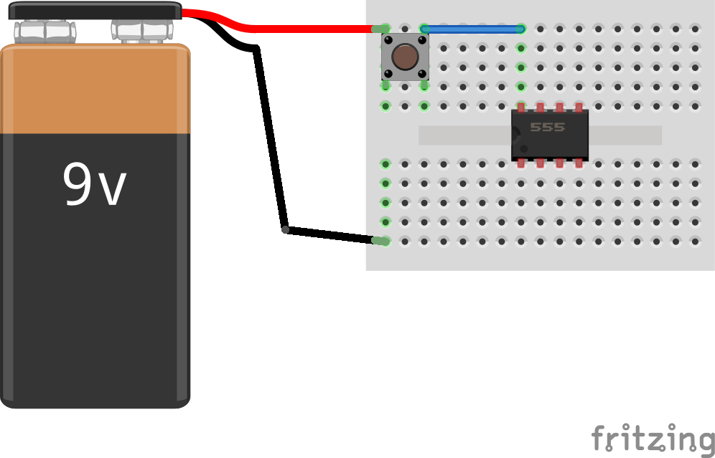
4: Add wire connecting the switch to the 555
Any colour of wire will work! Push each end of the wire into holes in the breadboard
Now, when the switch is pressed, the connection from the battery reaches this pin on the 555.

Slide 8

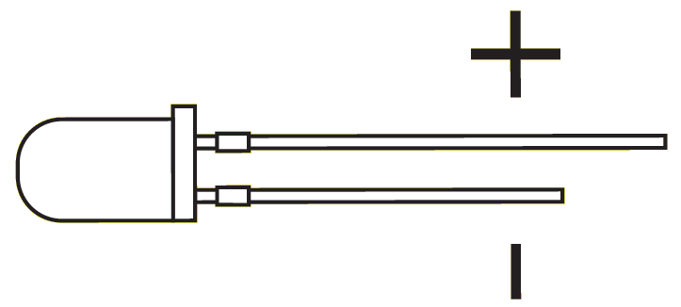
5: Add the LED connected to the switch.
Longer leg
Shorter leg
Make sure the longer leg goes at the switch end. We’re connecting positive end of the LED to the positive end (red cable) of the battery via the switch
An LED is a light emitting diode. It produces light when current flows through it.

Slide 9
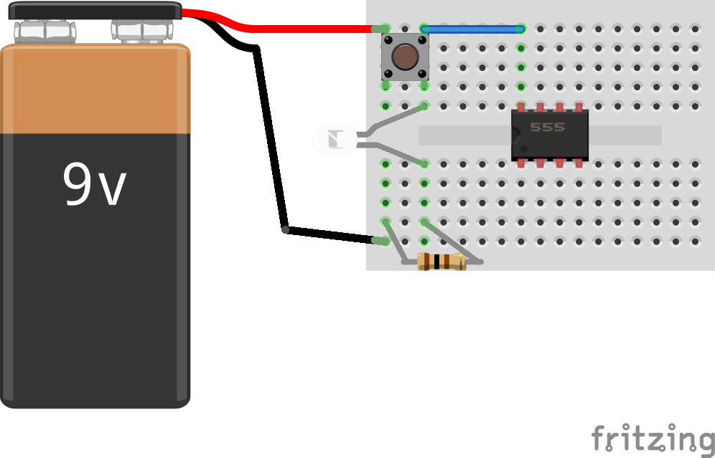
6: Add a resistor connecting the LED to the black (negative) battery cable
Remember components are connected together vertically along the terminal strip. See the green holes.

Slide 10

7: Add a wire connecting the black (negative) battery cable to the 555

Slide 11

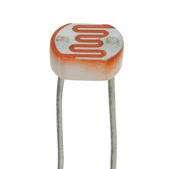
8: Connect the LDR to the switch and the 555
An LDR is a Light Dependant Resistor - the more light that it gets the less resistance it has which in this case will make the sound of our instrument go higher

Slide 12
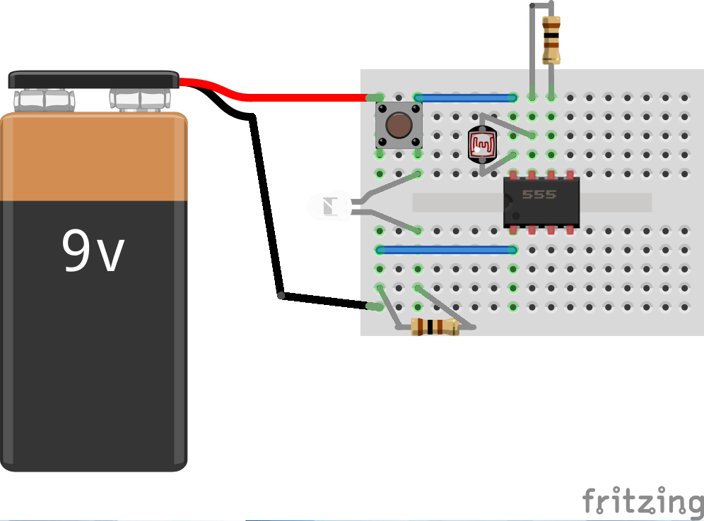
9: Add a resistor by the 555

Slide 13
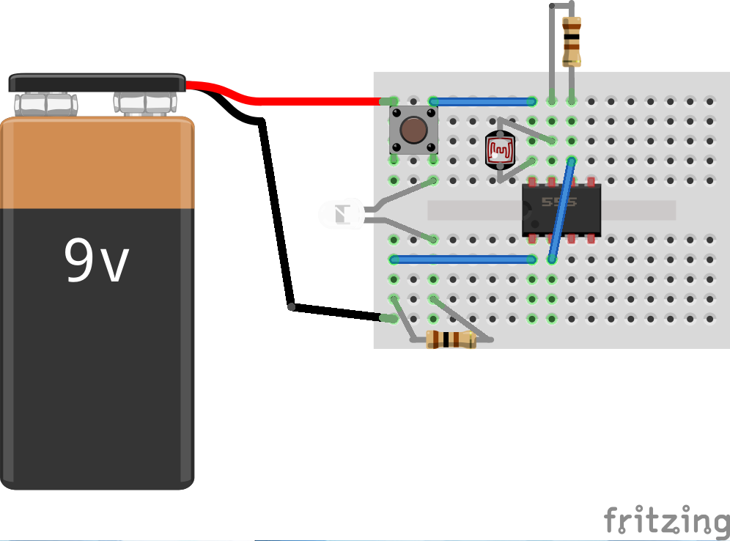
10: Add wire across 555

Slide 14
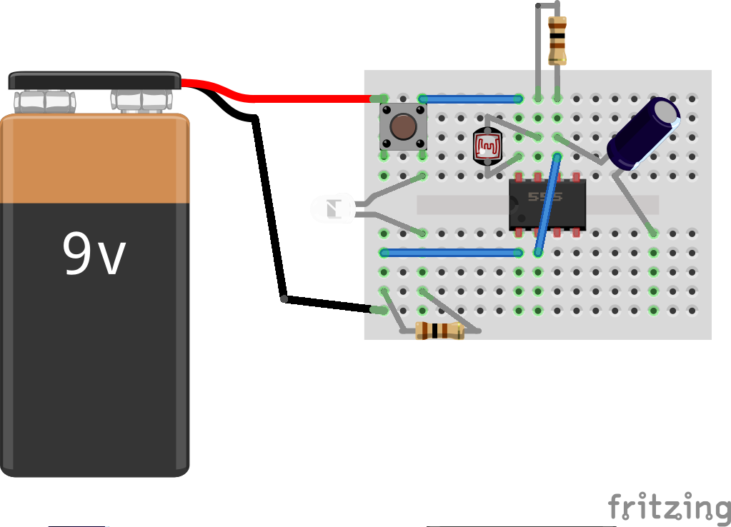
11: Add the smaller (2.2uF) Capacitor from 555
Make sure the shorter leg is
at this end

Slide 15

12: Add wire from the black (negative) battery to the capacitor

Slide 16
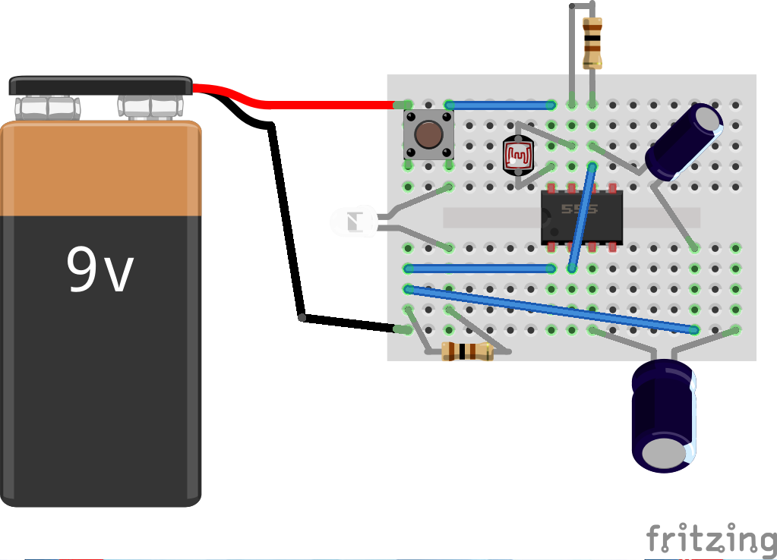
13: Add the bigger (100uF) capacitor from 555.
Make sure the shorter leg is
at this end

Slide 17
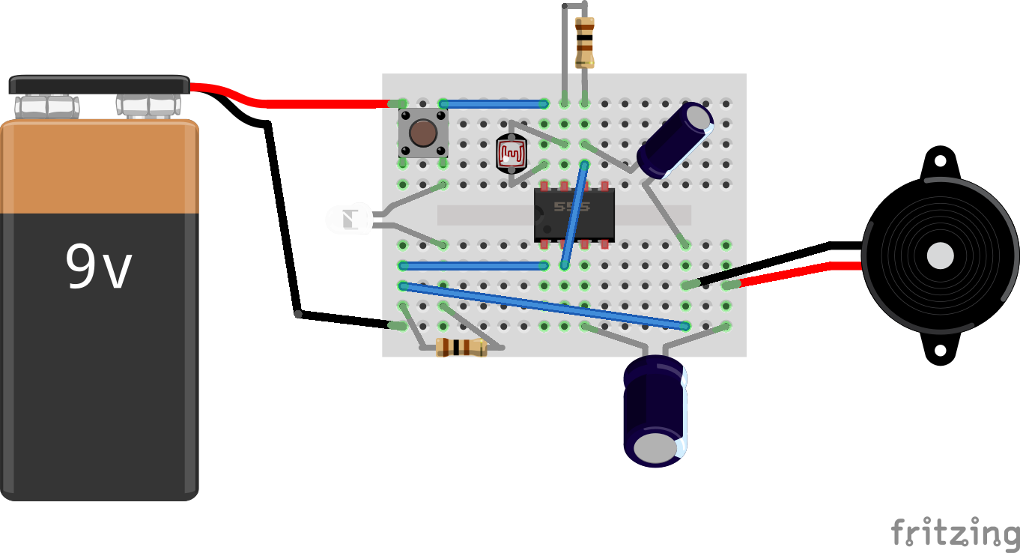
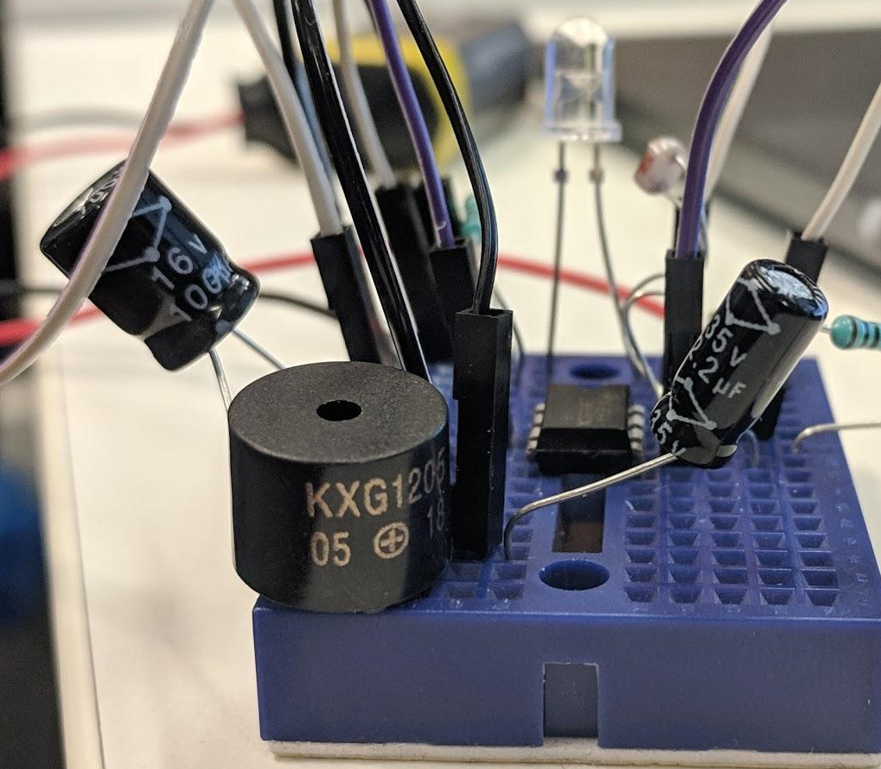
14: Connect the speaker between the capacitors.
Make sure the positive (+ symbol) is the side of the big capacitor

Slide 18
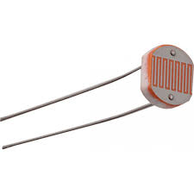
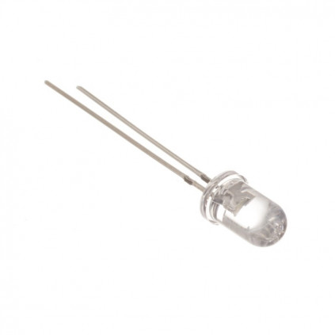
15: Connect the battery
If nothing is happening make sure the LED is pointing towards the LDR!
try pressing the button! Can you hear anything?

Slide 19
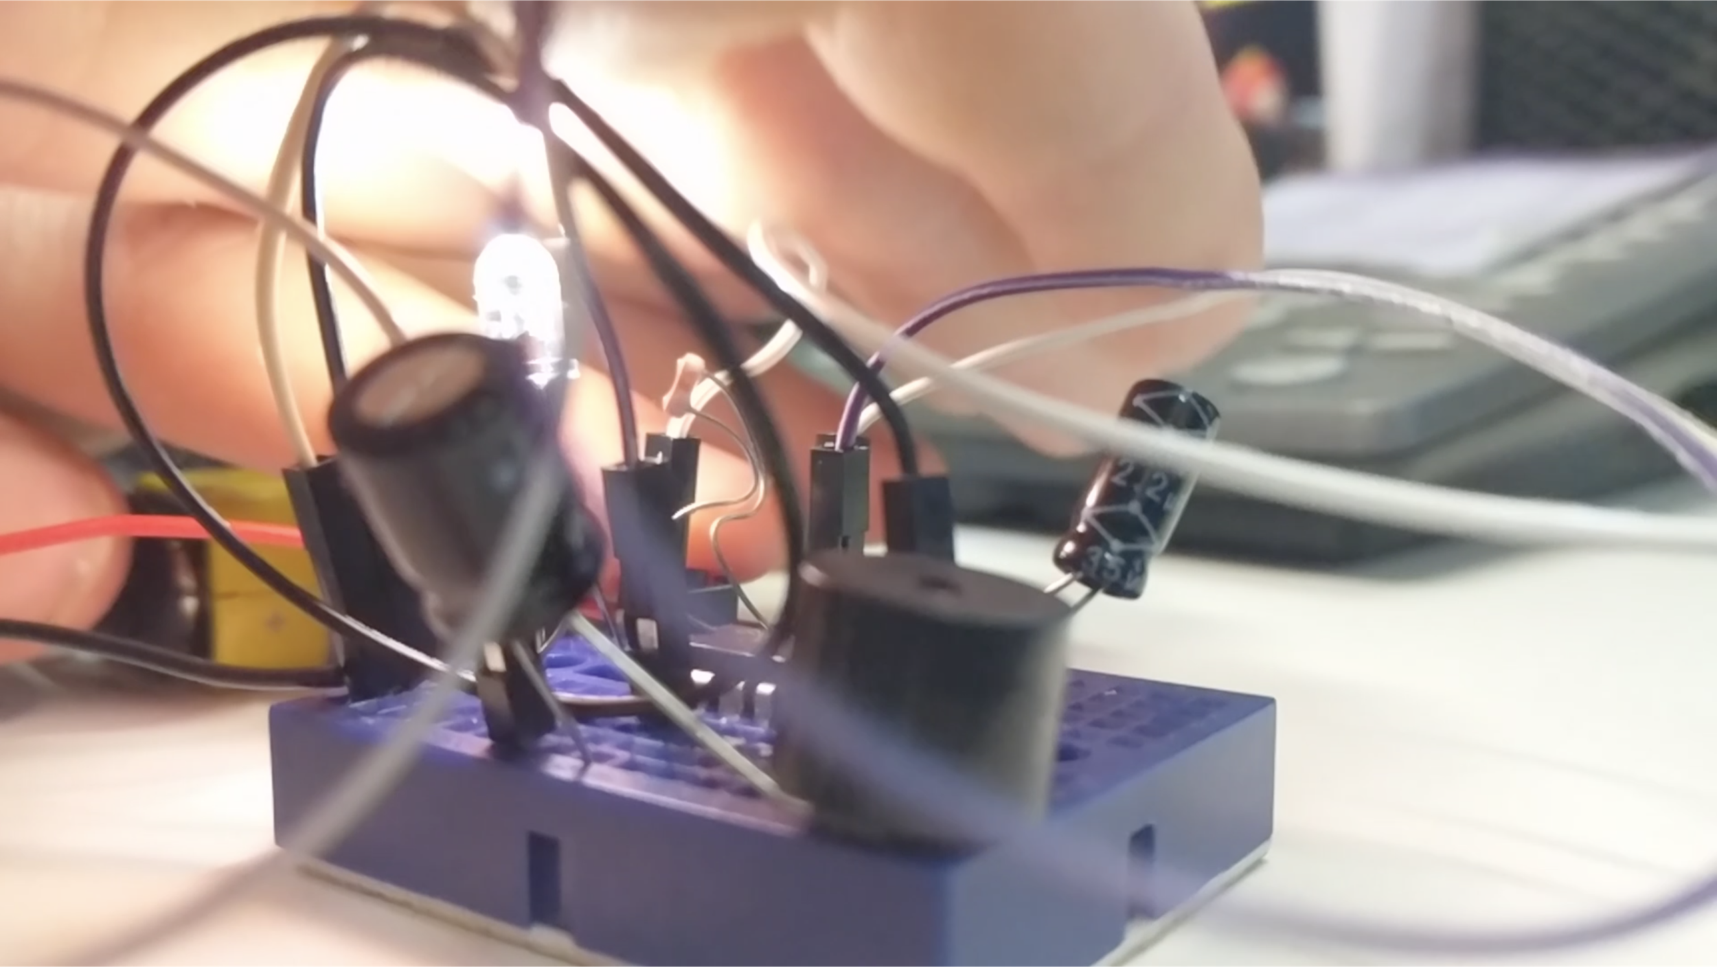
16: Try waving your hand in front of the LED light while pressing the button, what do you notice?

Slide 20
If you’ve got it set up right:
- as you put your hand closer to the LED you’re giving
-the LDR (light dependant resistor) more light and this causes
- its lower resistance and
- a higher pitch of your musical instrument! A higher sound.
And as you move you hand away it goes lower.

